Slide 1
A Brave Fly
By S. T.

Slide 2
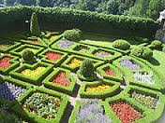
Once upon a time there was a fly named Ted. Ted lived at home in a garden with his brother, sister, and parents.
Mama fly
Papa fly
Sister fly
Brother fly
Ted
Garden (home)

Slide 3
One day Ted was arguing with his brother and sister, they said he was too chicken to do anything. So he proved them wrong and left home.

Slide 4
Ted was flying past a pond and landed on a lily pad close to the edge.

Slide 5
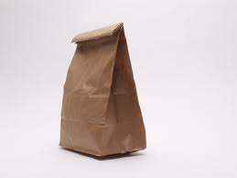
Next thing he knows he’s in a very dark paper bag.
Then he saw light and was let out into a tank with a …….

Slide 6
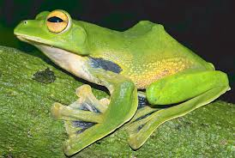
FROG!!!!!

Slide 7
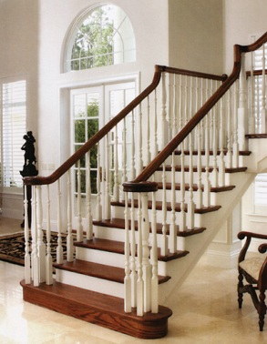
This frogs tongue was going crazy everywhere trying to catch Ted. There were foot steps coming up the stairs…

Slide 8
The lid on the tank came off and he flew out the tank and out the bedroom window.

Slide 9
He was lost and didn’t know where to go, so he flew up high in the sky and he could see his home from there.

Slide 10
He flew home, and proved his siblings wrong. His parents were worried and mad. But after that they lived happily ever after.

